Slide 1
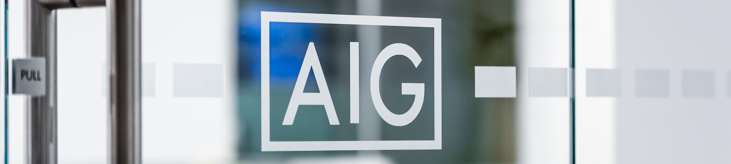
IT Modernization – DW Migration Weekly Status
For week ending March 4th , 2022

Slide 2
IT Modernization
Data – DW Migration for week ending 03/04/22
Overall Status | Schedule | Scope | Cost
At Risk | At Risk | In Progress | In progress
Inception
Elaboration
Design
Development
Deploy
Transition
Overall Summary
MA Auto – Discussed with App owner on different approaches for enforcing referential integrity for Pilgrim flow Mass State- Database table deployment completed in QA and QA validation was successful. Initiated the historical load. Autosys implemented in the dev GRA - Development completed for 4 sources DMS, CRS, ESP and CVL; Working on QA deployment ADP- Working with AWS and Postgres SME to find any potential performance bottlenecks ALIR- Started initial analysis; Had a call with SMEs on application overview Reviewed the Dev completion and QA deployment dates internally; Working with QA team to publish the dates
MA Auto
Accomplishments: Discussed with App owner on different approaches for enforcing referential integrity for Pilgrim flow
Next Steps: Implement code changes to fix referential integrity issue Merge the changes on current UDB with Snowflake Work with QA team for validation
Open Items: N/A
MassState
Accomplishments: QA: DDL deployment completed, and QA validation completed Initiated historical run in QA environment Autosys implemented in Dev/QA environment; Validation pending Java GUI demo internally; Plan for demo with business owner Error codes-based test cases has been reviewed with App team and business owner Working on ECR, CRC and Extraction modules
Next Steps: QA: Validate on historical load Work with QA team to get the QA timelines Complete development on ECR, CRC and Extraction modules Provide step by step demo to application team and business owner Provide demo on Java GUI with application team Raise request for SFTP connection for SR Automation and EFT server for higher environment Submitting SSA and initiating other release process
Open Items: N/A
TBD
Not Started
In Progress
At Risk
Late
Complete
Notes:
Make sure to fill in team name as well as the Accenture and AIG Leads in the top

Slide 3
IT Modernization
Data – DW Migration for week ending 03/04/22
Overall Status | Schedule | Scope | Cost
At Risk | At Risk | In Progress | In progress
Inception
Elaboration
Design
Development
Deploy
Transition
GRA
Accomplishments: QA: DDL QA validation completed for 8 schemas; Re-deploying DDL’s for fixing QA defects Historical load validation in progress for 7 schemas; Completed for 200 tables Working on POC for SnowSQL to load data into landing zones Provided issue analysis and workaround for JPA issue in DRA JAVA UI application Completed additional of audit column on LZ tables with current date as per new column requirement Development completed for 4 sources DMS, CRS, ESP and CVL; Pending QA deployment
Next Steps QA: Complete historical load validation for milestone 1 schemas Start QA validation on IICS task flows Address and close QA observations Deploy code to QA for DMS, CRS, ESP and CVL sources Validation of snowflake connections in IICS QA Continue the analysis and development of remaining source for US region Implement Snowsql for loading data into landing zone Start analysis on GRA ETL framework
Open Items: DRA & SAM JAVA UI based JPA objects are not supported in snowflake database
ADB
Accomplishments: Working with AWS SME’s Michael Quale/Pradeep for tracing performance bottleneck Working with Postgres SME to optimize the procedure like Hot Updates and changing Fill factor while updating
Next Steps: Summarize and distribute the changes implemented and validated Finalize the plan for ADB Revisit timelines with application owner
Open Items: Performance Issue with Maintenance Module
ALIR
Accomplishments: Initiated calls with application owner for an overview As recommended by application team , analysis will be segregated by states
Next Steps Work closely with application team to understand JOB/Program flow for NY state Understand the details on Java GUI dependencies Prepare playback document for each module
Open Items: N/A
TBD
Not Started
In Progress
At Risk
Late
Complete
Notes:
Make sure to fill in team name as well as the Accenture and AIG Leads in the top

Slide 4
IT Modernization
Data – DW Migration for week ending 03/04/22
Inception
Elaboration
Design
Development
Deploy
Transition
Upcoming Key Milestones | Additional Comments | Original date | Revised date
Mass State Code Release |  | 04/15/2022
Open Items
N/A
TBD
Not Started
In Progress
At Risk
Late
Complete
Notes:
Make sure to fill in team name as well as the Accenture and AIG Leads in the top

Slide 5
IT Modernization Meeting Minutes 02/25/22
Publish QA ,UAT and Prod dates to QA, DevOps teams
Review documentation outlining the issue and the remediation taken to circumvent issue. And the approach for the migration

Slide 6
IT Modernization
Data
RAID Log

Slide 7
*All times are in EST
IT Modernization
Reoccurring Cadences on a Weekly Basis
Module | Ad Hoc | Monday | Tuesday | Wednesday | Thursday | Friday
Program |  | Weekly Status (1 PM – 2 PM EST) | IT Modernization Program Status (8:00-9:00 AM EST)
Hadoop |  | Daily Stand-Up (10 – 10:30 AM EST) | Daily Stand-Up (10 – 10:30 AM EST) | Daily Stand-Up (10 – 10:30 AM EST) | Daily Stand-Up (10 – 10:30 AM EST) | Daily Stand-Up (10 – 10:30 AM EST)
DW |  | Daily Stand-Up (9:30 – 10 AM EST) | Daily Stand-Up (9:30 – 10 AM EST) | Daily Stand-Up (9:30 – 10 AM EST) | Daily Stand-Up (9:30 – 10 AM EST) Weekly Status (10:00 AM – 10:30 AM EST) | Daily Stand-Up (9:30 – 10 AM EST)
Cognos |  | Daily Stand-Up (10:30 – 11 AM EST) | Daily Stand-Up (10:30 – 11 AM EST) | Daily Stand-Up (10:30 – 11 AM EST) | Daily Stand-Up (10:30 – 11 AM EST) Weekly Status (11:00 AM – 11:30 PM EST) | Daily Stand-Up (10:30 – 11 AM EST)
DataStage |  | Daily Stand-Up (10 – 10:30 AM EST) | Daily Stand-Up (10 – 10:30 AM EST) | Daily Stand-Up (10 – 10:30 AM EST) | Daily Stand-Up (10 – 10:30 AM EST) | Daily Stand-Up (10 – 10:30 AM EST)
Notes:
Please update with any meetings between Accenture and AIG

Slide 8
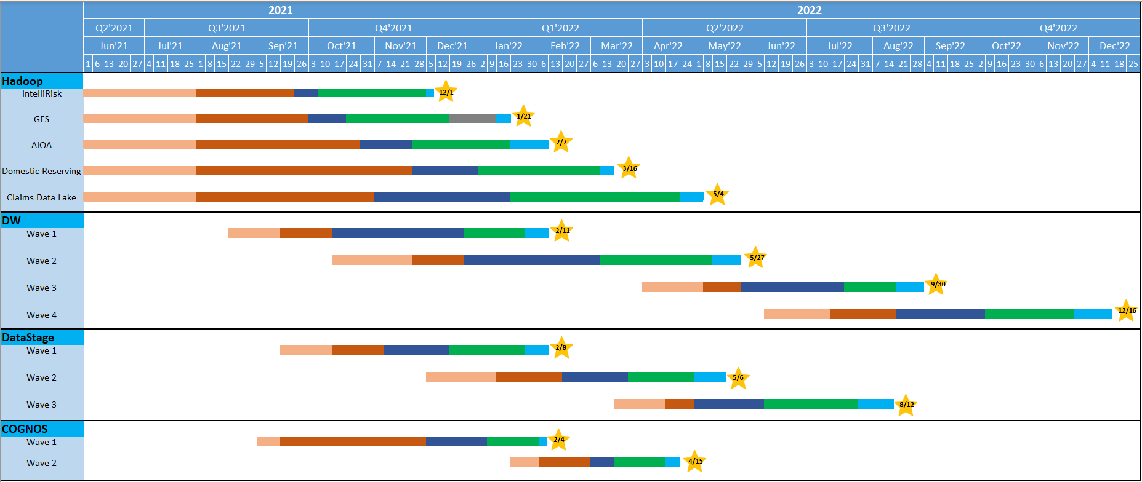
Project Schedule – High Level

Slide 9
Appendix

Slide 10

Scope of Work by Module
Tower | IT Mod Modules | Scope
CLOUD | Cloud Strat & Op Mod | Establish Cloud Center of Enablement (CCoE), defining, building and supporting the standard architecture and services making up the Cloud platform.
 | Cloud Foundation | Design, build and deliver a secure Cloud Foundation, which consists of a new AWS environment and enhanced Azure, GCP, Private Cloud environments.
 | Migration (DC Exit) | Stand up the Migration Factory Capability; rehost and relocate applications with cloud-ready servers to AWS EC2 and AWS VMC; Relocate applications with non-cloud-ready servers from the Livingston, NJ data center to the Secaucus, NJ Equinix colocation facility
 | App Transformation | Execute the Level 1 (Analysis) and Level 2 (design & estimation) for application modernization. Execute on the modernization work to replatform non-cloud ready applications to enable deployment to the cloud.
 | Op Resiliency | Determine business requirements for application-level resiliency and apply architecture patterns in migration and modernization
END USER SERVICES | Active Directory | Design and build a future-state ready Active Directory infrastructure; Migrate applications, users, workstations and servers to leverage Azure AD; Enhance security posture by modernizing integrated AD toolsets
 | App Virtualization | Drive workstation application virtualization in support of WVD rollout
 | Cloud Managed Device | Design, build and roll out infrastructure to support End User Device Management from the cloud using Microsoft Intune and co-Management with SCCM​; Enable Autopilot to complement DaaS from Dell for break/fix and remote rebuild scenarios
 | Teams | Consolidate and migrate IM, Presence, Meetings, dial-in conferencing, and Enterprise Voice workloads from Cisco WebEx, Skype for Business Server, and Avaya/Cisco/legacy telephony solutions to Microsoft Teams
 | Windows Virtual Desktop | Design, build and transition from Citrix XenDesktop as the default end user virtualization solution to Azure Windows Virtual Desktop (WVD)​.
NETWORK | Genesys Cloud (Contact Center) | Migrate existing IVR logic, call flows, reporting, call recording and workforce management capabilities to the Genesys PureCloud platform. Functionality will be like for like in nature and replicate current capabilities in place in the current system.
 | Security Segmentation | Enable network security segmentation from users and devices to applications by extending existing Palo Alto footprint and applying policy based on users and groups.
DATA | Data | Hadoop to Snowflake/AWS cloud migration; Data warehouse migration; Re-platform Data Stage from AIX to Linux servers; Cognos version upgrade and recompile reports as is;
PROGRAM GOVERNANCE & CHANGE | PMO / Change Mgmt. / BU Engagement | Overall governance workstream to manage, track, and drive successful adoption of transformation and run initiatives.
Regional Data Centers
New Hybrid Cloud
Legacy Devices & Collaboration
Cloud-Managed Devices & Collab
On-Prem Network & Call Center
Cloud Enabled Network & Call Center
Unconsolidated Data, Legacy Tech
Cloud-based Data Landscape
Governance & Reporting
Integrated Governance & Change at Scale

Slide 11
IS Program Governance
Program Sponsors
John Repko / John Cusano / Shane Fitzsimmons / Gary Fink
AIG200 SteerCo
Quarterly
AIG 200 Program Leadership
David Radvany / Suhas Yerra / David Ditillo / Marianne Bachynski / Richard Shannon / Jaime Lijeron /
Keyur Patel / Rich Baich / Mo Raut / Michael Galloway / Michael O’Malley /
Int’l CIO Council /
Jason Davis
Control Functions
Steve Fernandez / Parita Patel / George Weber / Amy Gnagy / Bob Schmitt
CIOs
Legal: Liz Kelly
TRC: Mick Prosser
Procurement: TBD
IS Finance: Tara Axler & Sal Severini
ISO: Ed Hayes / Jason Hamilton
Audit: Jared Henderson
IT Mod Technical Leadership
CIO/CTO SteerCo
Monthly
Paolo Palombo / Sebastian Migliaccio / Jason Sauviac / Craig Rodgers / Rob Pinkham / Mark Hodson
Program & Change Mgmt.
Nigel Mullis / Gul Chaudhary / Elizabeth Waweru / Jo Leahy / George Weber / Julie Manis / Ben Aguilar / Kristin Lee
Operations / Service Introduction
Paolo Palombo / Scott Peterson
Working Group
CIO Delegates / BU Engagement
Matt Ashcraft / Shifad Wahid / Aravind Narayanan / Pat Nadeau / Deepak Shamarao / Madhu Nukala / Krishna Tirunagari / Tom McCabe / Jason Hamilton
ACCN TBD
IS Program Management
Weekly
International Service Delivery
Dan Marsh (International), Alfredo Chavez (LA), Mike Reeder (UK), Alex Evaristo (EMEA), Mabes Suleman (APAC) and Alex Substanley (Japan)
Cloud
Data
EUS
Network
Strategic Programs
Real Estate
Paolo Palombo / Craig Rodgers / Asish Bala / Tamir Segal
Julie Manis / Mark Kaffenberger / Shaan Mulchandani / Mano Yerreddu / Lorena Ruiz Monroy
Mark Hodson /
Amit Narielwala
Lee Shimshi
Sri Chintala
Sebastian Migliaccio / David Crome
Rafi Reza
Susan Hirai
Jason Sauviac /
Michael Kahn
Ryan Wickham
George Weber /
Mark Thomas
(EIP – Gwen Gautsch)
Managed Services Transition: Scott Peterson / Alex Sahaydak
Robin Mooney
Working Group
Meetings as Needed
LEGEND:
AIG
Accenture
AWS

Slide 12
IT Modernization | Program Governance Meetings & Cadence
Meeting | Members / Attendees | Facilitators | Cadence | Purpose
AIG 200 Program Steering Committee To Be Scheduled | John Repko / John Cusano / Shane Fitzsimmons / Gary Fink Steve Fernandez, Amy Gnagy, Paolo Palombo, Rob Pinkham | George Weber | Quarterly – 1 Hour | Overall Program Status Update Make key strategic program decisions Provide final approval of major program decisions Address escalations raised by CIOs & Working Group Leadership
Weekly Passport Sponsor Pulse | IT Leadership Steve Fernandez, Parita Patel, Amy Gnagy | Steve Fernandez, Amy Gnagy | Semi-Monthly– 30 Mins | IT Mod + Managed Services program update
CIO / CTO Steering Committee To Be Scheduled | CIOs Steve Fernandez, Amy Gnagy, George Weber Paolo Palombo, Rob Pinkham CIO Delegates Working Group Workstream Leads Program Leads | George Weber, Nigel Mullis, Ben Aguilar | Monthly – 1 Hour | Overall Program Status Update Address escalations raised by CIO Delegates
CTO Steering Committee To Be Scheduled | Steve Fernandez, Amy Gnagy George Weber, Paolo Palombo, Jason Sauviac, Sebastian Migliaccio, Craig Rodgers, Dan Marsh, Nigel Mullis Rob Pinkham, Ben Aguilar | Nigel Mullis, Ben Aguilar | Weekly – 30 minutes | Early identification of risks and flagging where leadership help, awareness, or support is needed Exception management of major program issues - agenda and additional attendees driven from Program Management Status exceptions
IS Program Management Status | Paolo Palombo, Rob Pinkham CIO Delegates Working Group Workstream Leads Control Groups (TRC, ISO, etc.) Project Managers Program Governance & Change Fernandez/Gnagy as required | Ben Aguilar, Nigel Mullis | Weekly – 1 Hour | Overall Program Status Update: Review status and discuss issues, blockers, risks, planning for next meeting Address escalations raised by Working Teams Review key activities by team Provide guidance across Working Teams and disseminate information across workstreams Coordinate cross team dependencies RAID Review
Working Group Team Meetings | Working Group Workstream Leads Project Managers CIO Delegates | Project PMs / Leads | As Needed | Meet across workstreams to provide input and coordinate as needed on activities

Slide 13
IT Modernization
Data
Overall Status | Schedule | Scope | Cost
In Progress | In Progress | In Progress | In Progress
Inception
Elaboration
Design
Development
Deploy
Transition
Accenture Lead
AIG Lead
Overall Summary
Enter here
Accomplishments | Date
Next Steps | Date
Upcoming Key Milestones | Date
Points for Leadership Attention
Enter here
ID | Date Added | RAID Item | Severity | Raised By | Module | RAID Item | Owner | Status | Notes
TBD
Not Started
In Progress
At Risk
Late
Complete
Notes:
Make sure to fill in team name as well as the Accenture and AIG Leads in the top

